Slide 1

The minimum of a microscope?
Abbe’s equation
NA: Numerical aperture
σ: Spatial resolution
The resolution limit of an optical microscope is half the wavelength of light. The wavelength of visible light is between 400 and 760 nm, so the resolution limit of an optical microscope is 200 nm (0.2 microns). Objects smaller than 0.2 microns cannot be resolved by an optical microscope.

Slide 2
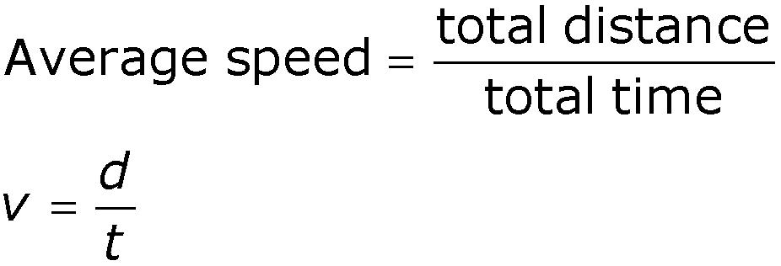
Speed
The average speed of an object is defined as the total distance traveled divided by the total time elapsed
scalar
  Speed is a scalar quantity (units = m/s)

Slide 3
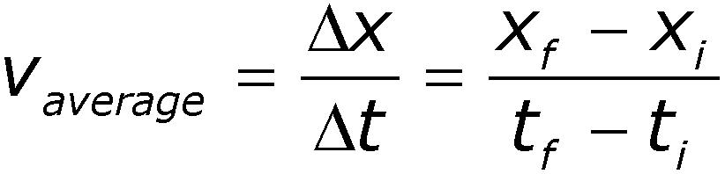
Velocity
It takes time for an object to undergo a displacement
The average velocity is the rate at which the displacement occurs
vector
Direction will be the same as the direction of the displacement

Slide 4
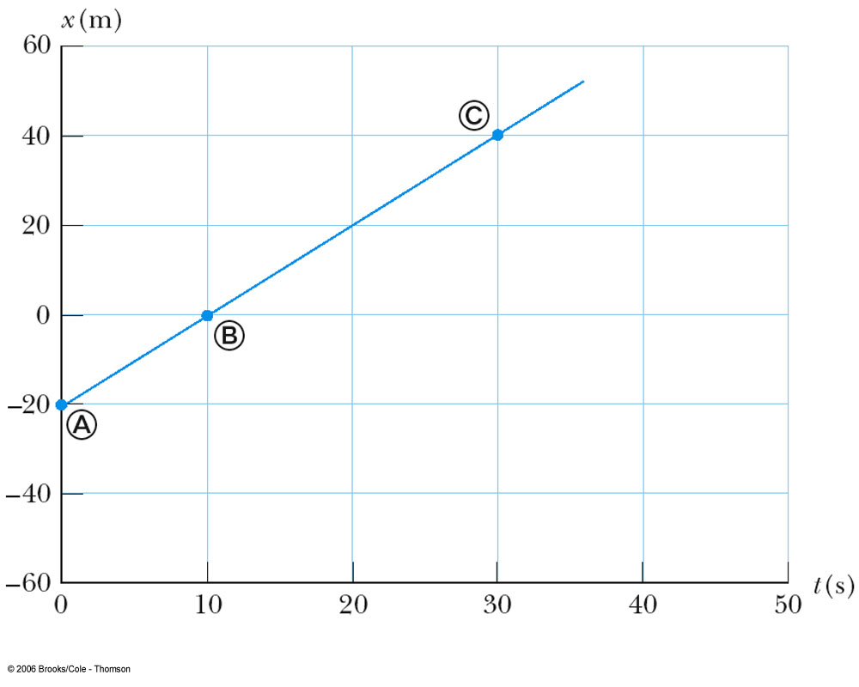
Constant Velocity
The straight line indicates constant velocity
The slope of the line is the value of the average velocity

Slide 5
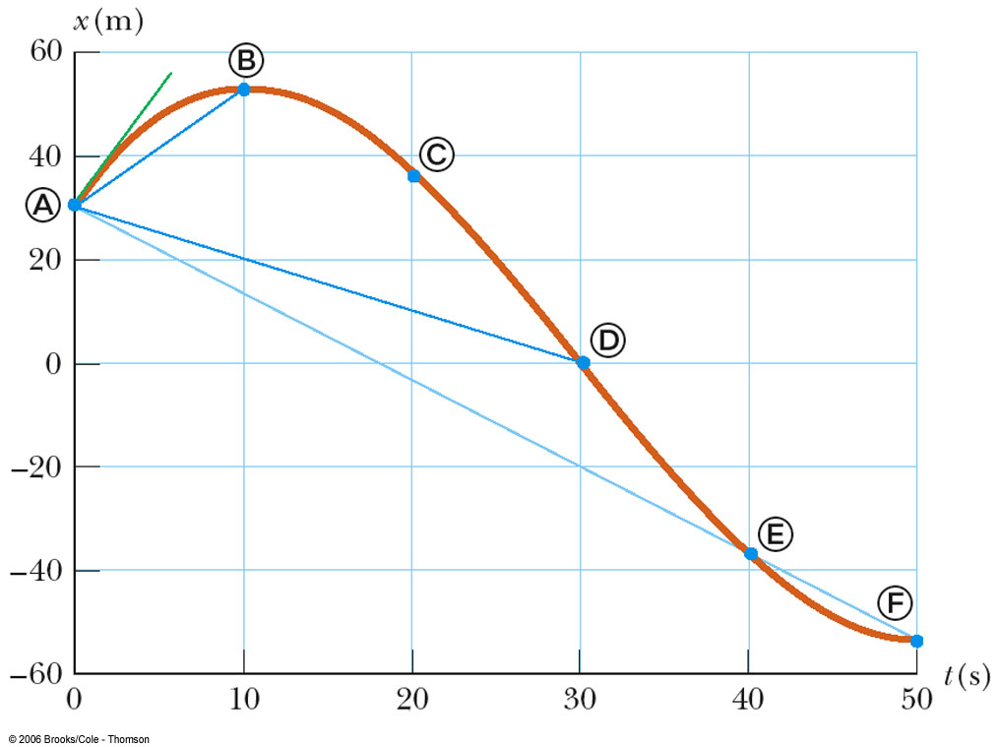

Complex velocity
The red line is for a time changing velocity
The average velocity is the slope of the blue line joining two points

Slide 6
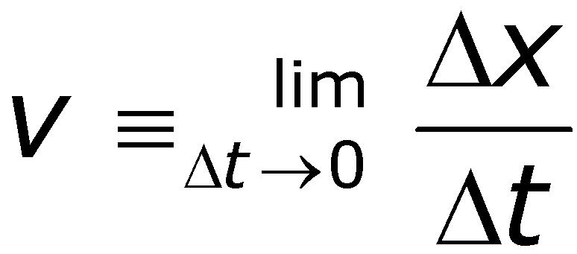

Instantaneous Velocity
The limit of the average velocity as the time interval becomes infinitesimally short (I.e., as the time interval approaches zero)
The instantaneous velocity is what happens at each point of time
Its value is a tangent line at a point

Slide 7
Question: how to get the average velocity and instantaneous velocity in a x-t curve?
The average velocity is the slope of the blue line joining two points
The instantaneous velocity a tangent line at a point

Slide 8
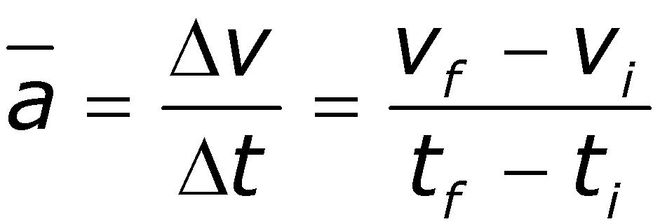
Acceleration
Changing velocity means an acceleration is present
Acceleration is the rate of change of the velocity
Units are m/s² (SI), cm/s² (cgs), and
ft/s² (US Cust)

Slide 9
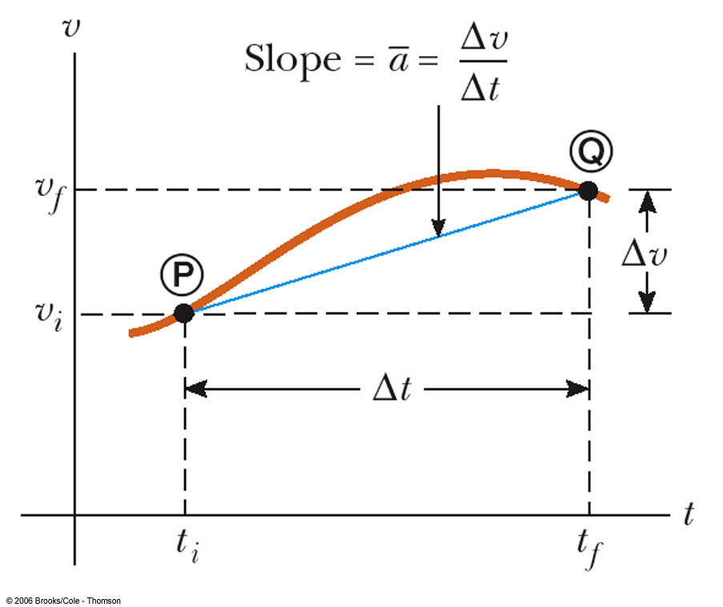
Average Acceleration

Slide 10
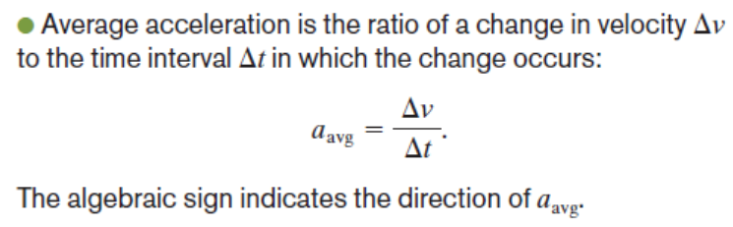
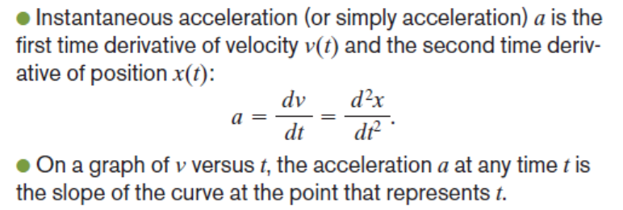

Instantaneous Acceleration

Slide 11
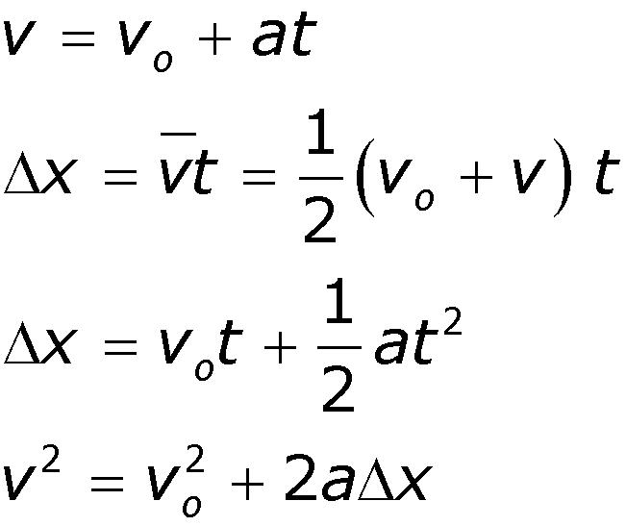
Kinematic Equations
For uniform acceleration

Slide 12
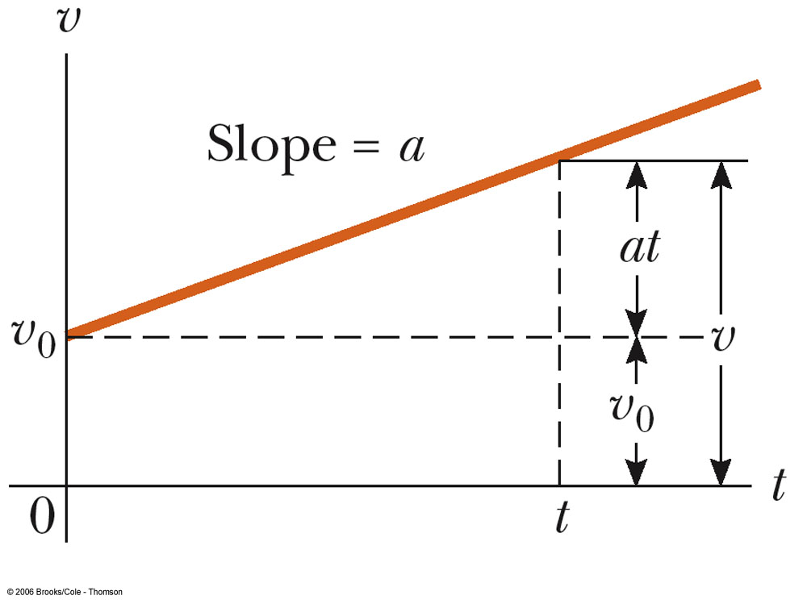
Graphical Interpretation

Slide 13


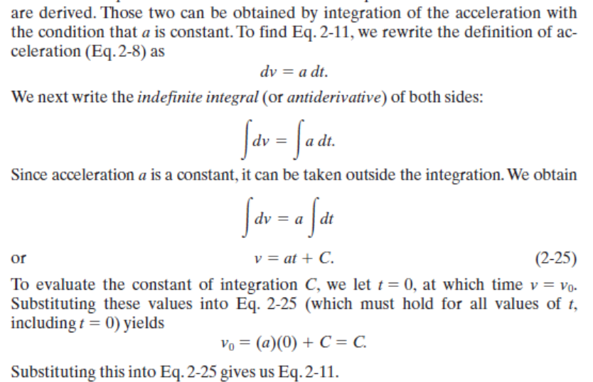


Slide 14

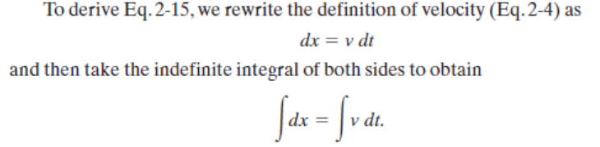
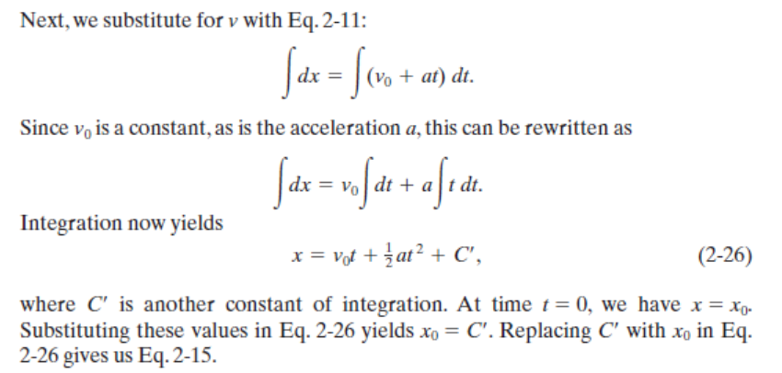

Slide 15
Acceleration due to Gravity: Free Fall
Symbolized by g
g = 9.80 m/s²
  When estimating, use g ≈ 10 m/s²
g is always directed downward
  toward the center of the earth
Ignoring air resistance and assuming g doesn’t vary with altitude over short vertical distances, free fall is constantly accelerated motion

Slide 16
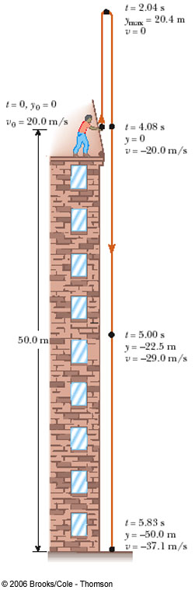
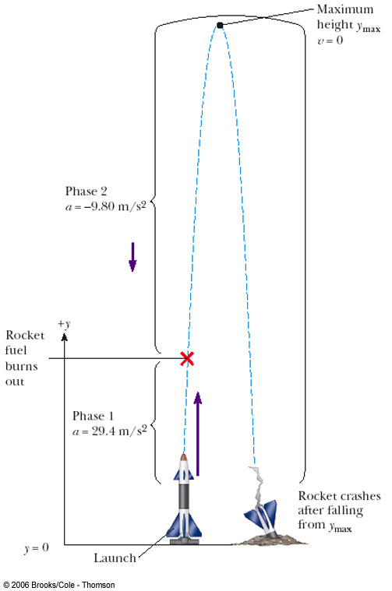
Free Fall Problems

Slide 17

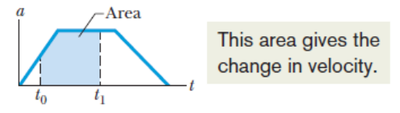
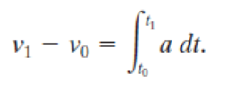

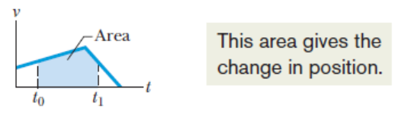

Graphical Integration in Motion Analysis

Slide 18
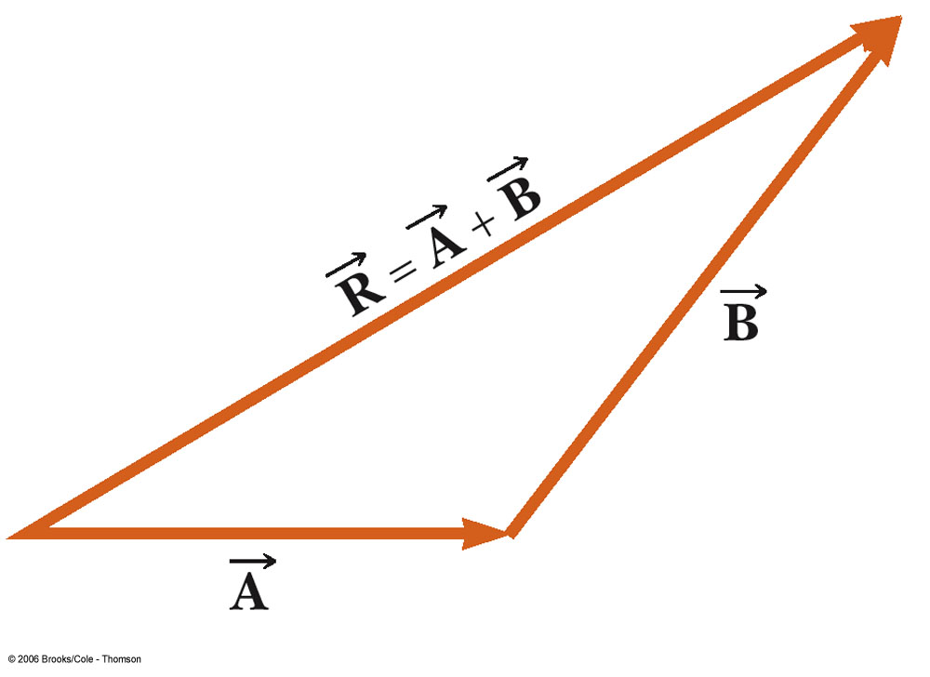



Graphically Adding Vectors
Draw the vectors “tip-to-tail”
The resultant is drawn from the origin of to the end of the last vector
Measure the length of and its angle
  Use the scale factor to convert length to actual magnitude

Slide 19
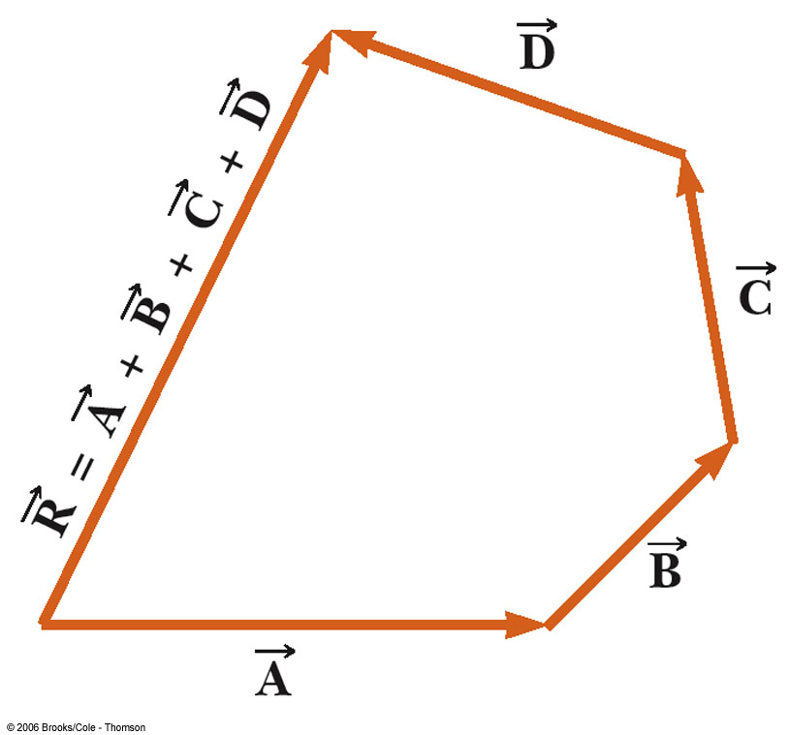
Adding Many Vectors
When you have many vectors, just keep repeating the process until all are included
The resultant is still drawn from the origin of the first vector to the end of the last vector

Slide 20
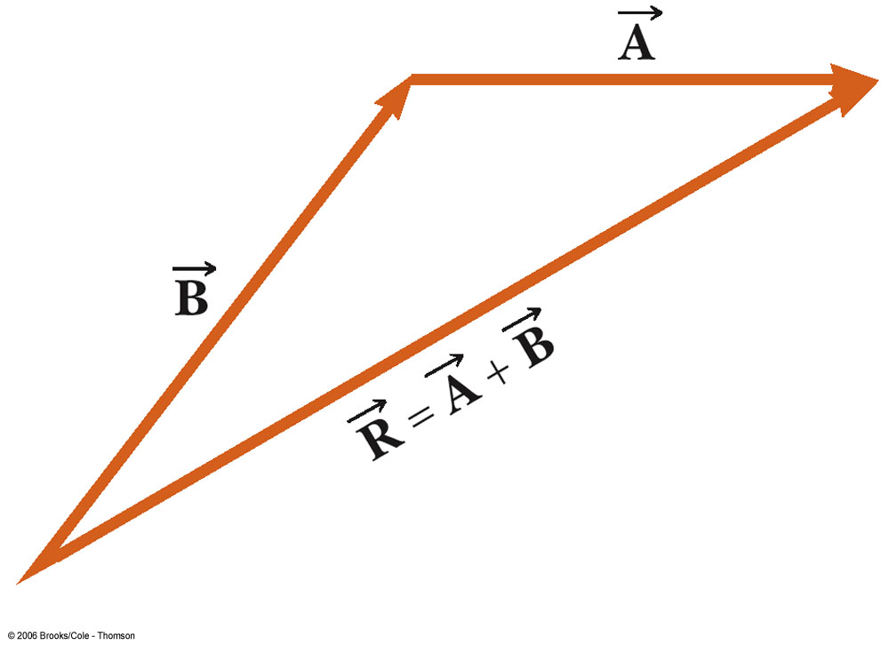
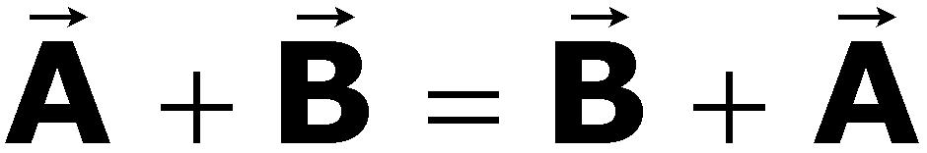
Notes about Vector Addition
Vectors obey the Commutative Law of Addition
  The order in which the vectors are added doesn’t affect the result

Slide 21
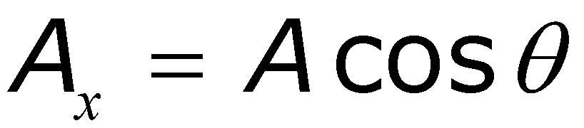
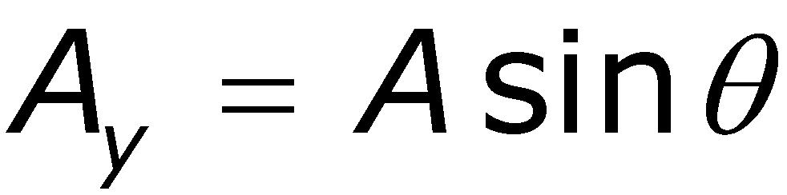
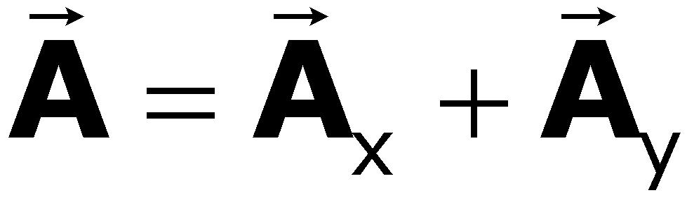
Components of a Vector, cont.
The x-component of a vector is the projection along the x-axis
The y-component of a vector is the projection along the y-axis
Then,

Slide 22
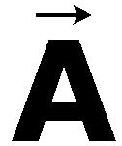
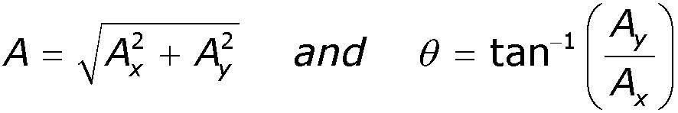
More About Components
The components are the legs of the right triangle whose hypotenuse is
  May still have to find θ with respect to the positive x-axis
IMPORTANT:
  The value will be correct only if the angle lies in the first or fourth quadrant
  In the second or third quadrant, add 180°

Slide 23
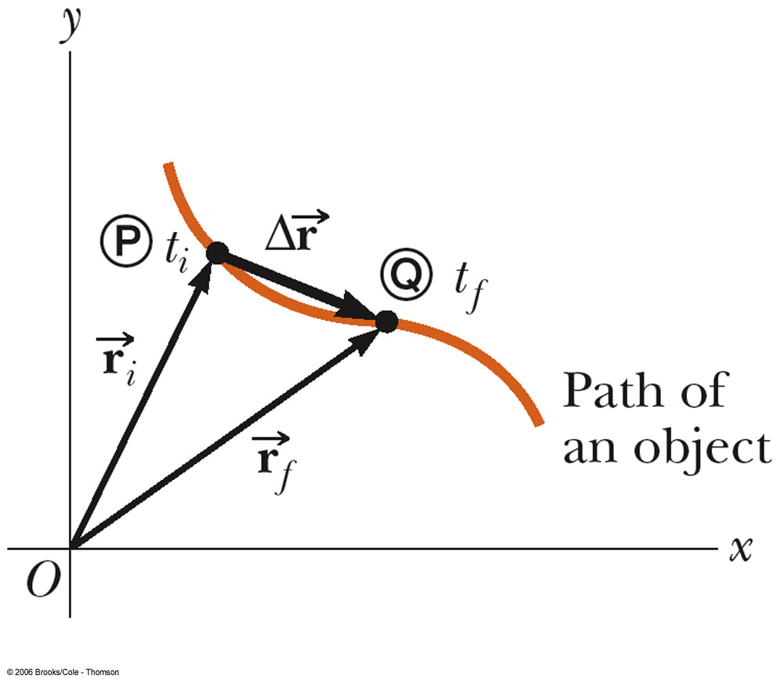

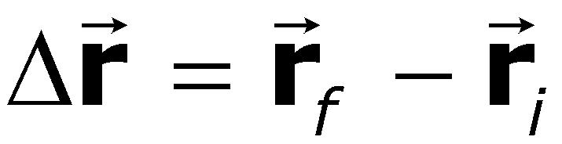
2D Displacement
The position of an object is described by its position vector,
The displacement of the object is defined as the change in its position

Slide 24
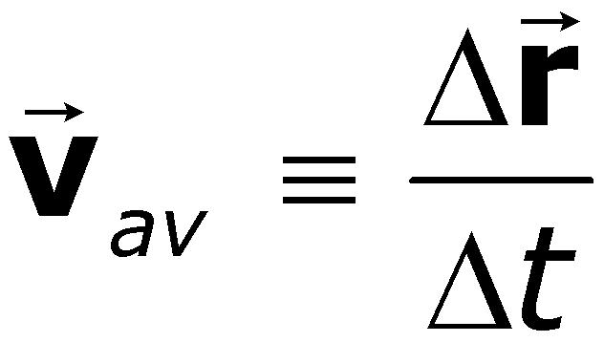
Velocity
The average velocity is the ratio of the displacement to the time interval for the displacement
The instantaneous velocity is the limit of the average velocity as ∆t approaches zero
  The direction of the instantaneous velocity is along a line that is tangent to the path in the direction of motion

Slide 25
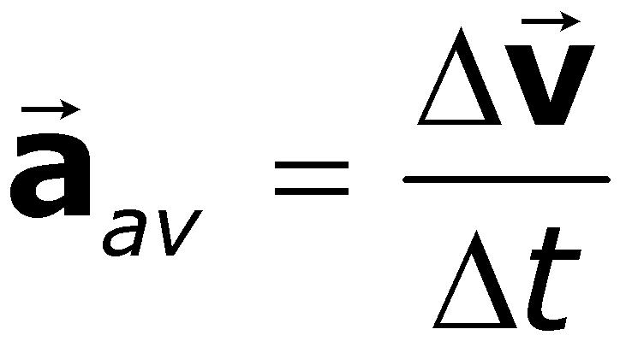
Acceleration
The average acceleration is defined as the rate at which the velocity changes
The instantaneous acceleration is the limit of the average acceleration as ∆t approaches zero
Acceleration can result from change in speed or change in direction

Slide 26
Projectile Motion
An object may move in both the x and y directions simultaneously
  It moves in two dimensions
The form of two dimensional motion we will deal with is called projectile motion
  We may ignore air friction
  We may ignore the rotation of the earth
  With these assumptions, an object in projectile motion will follow a parabolic path

Slide 27
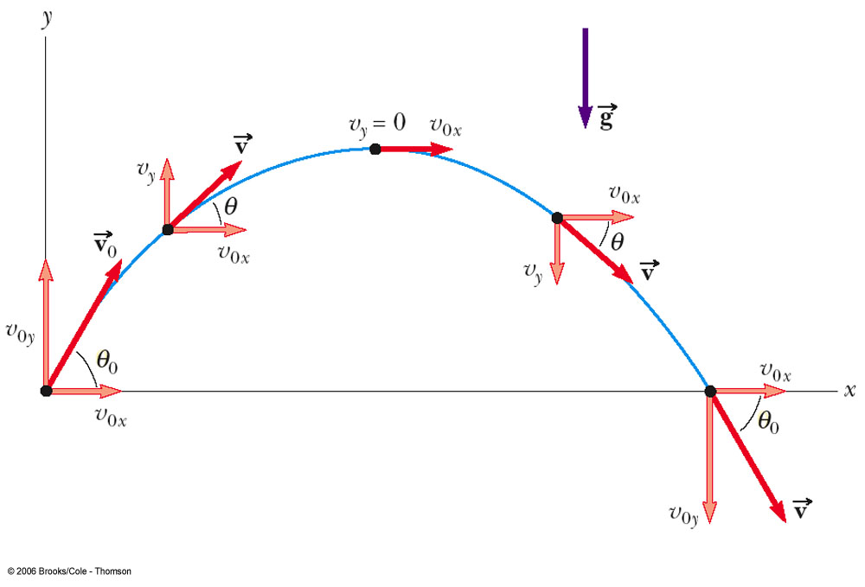
Projectile Motion

Slide 28
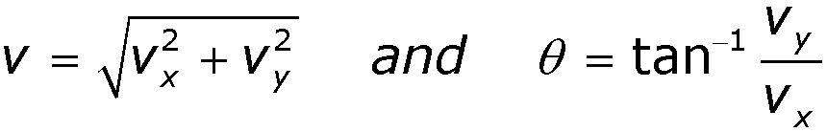
Velocity of the Projectile
The velocity of the projectile at any point of its motion is the vector sum of its x and y components at that point
  Remember to be careful about the angle’s quadrant

Slide 29
Chapter 4
The Laws of Motion

Slide 30
Newton’s First Law
An object moves with a velocity that is constant in magnitude and direction, unless acted on by a nonzero net force

Slide 31
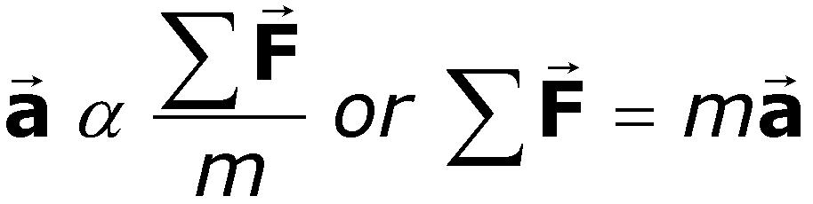

Newton’s Second Law
The acceleration of an object is directly proportional to the net force acting on it and inversely proportional to its mass.

Slide 32
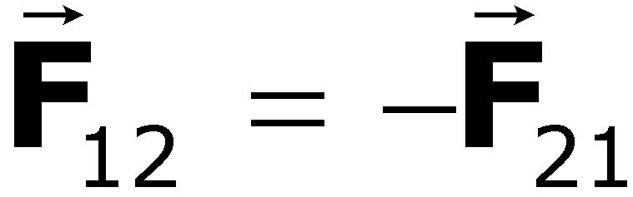
Newton’s Third Law
If object 1 and object 2 interact, the force exerted by object 1 on object 2 is equal in magnitude but opposite in direction to the force exerted by object 2 on object 1.
  Equivalent to saying a single isolated force cannot exist

Slide 33
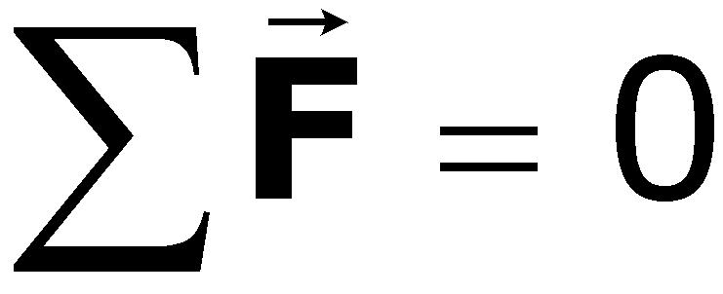
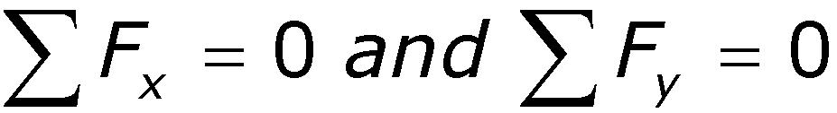
Equilibrium
An object either at rest or moving with a constant velocity is said to be in equilibrium
The net force acting on the object is zero (since the acceleration is zero)

Slide 34
Chapter 5
Energy

Slide 35
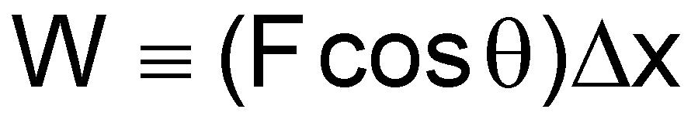
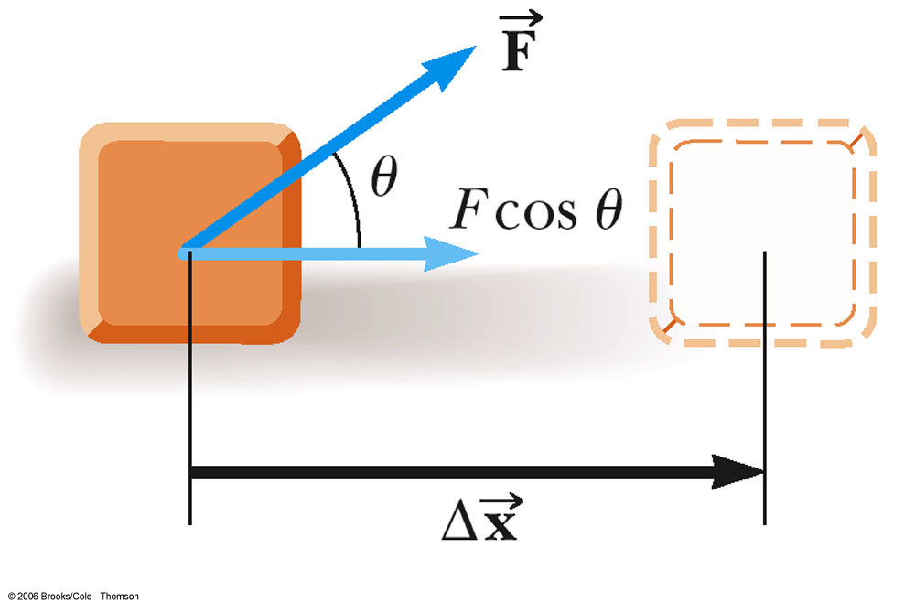
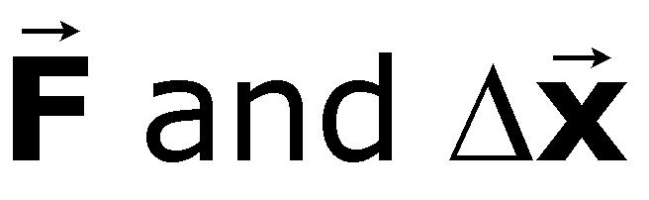
Work - Energy and Force
  F is the magnitude of the force
  ∆x is the magnitude of the object’s displacement
  θ is the angle between

Slide 36
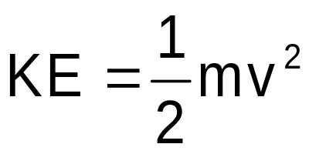

Kinetic Energy
Energy associated with the motion of an object:
Scalar quantity with the same units as work
Work-Kinetic Energy Theorem
  Speed will increase if work is positive
  Speed will decrease if work is negative

Slide 37
Potential Energy
Potential energy is associated with the position of the object within some system
  Potential energy is a property of the system, not the object
  A system is a collection of objects interacting via forces or processes that are internal to the system

Slide 38
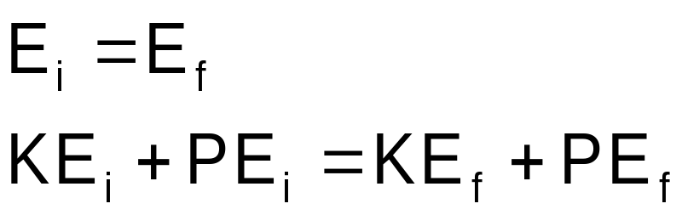
Conservation of Energy
Total mechanical energy is the sum of the kinetic and potential energies in the system
  Other types of potential energy functions can be added to modify this equation

Slide 39
Springs
Involves the spring constant, k
Hooke’s Law gives the force
  F = - k x
    F is the restoring force
    F is in the opposite direction of x
    k depends on how the spring was formed, the material it is made from, thickness of the wire, etc.
    The force is conservative for “ideal” springs, so there is an associated PE function

Slide 40
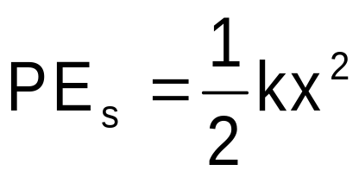
Spring Potential Energy
Elastic Potential Energy
  related to the work required to compress a spring from its equilibrium position to some final, arbitrary, position x

Slide 41
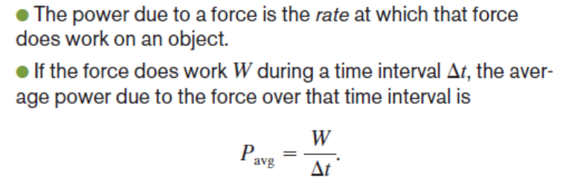
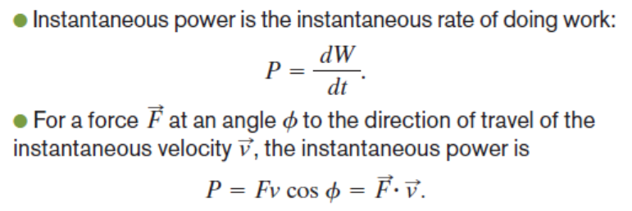
Power - Energy Transfer

Slide 42
Center of Mass
The point in the body at which all the mass may be considered to be concentrated
  When using mechanical energy, the change in potential energy is related to the change in height of the center of mass

Slide 43
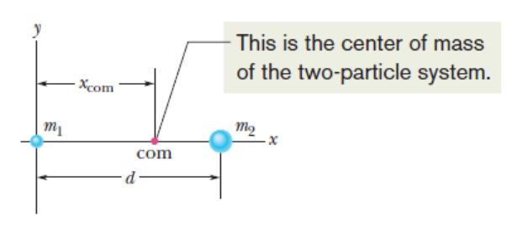

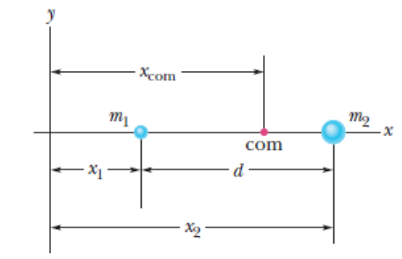

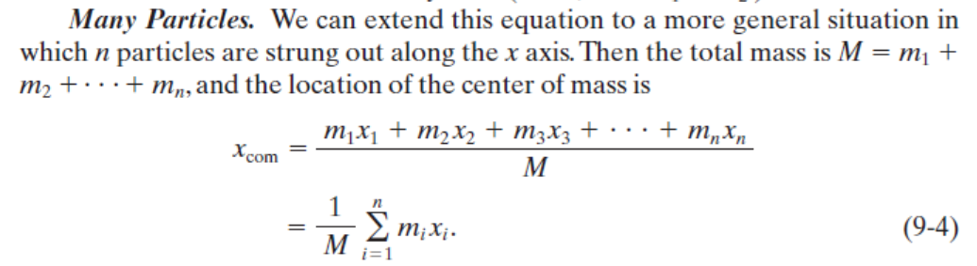

Slide 44
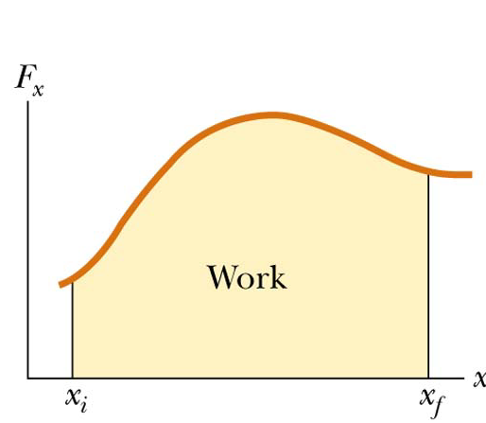
Work Done by Varying Forces
The work done by a variable force acting on an object that undergoes a displacement is equal to the area under the graph of F versus x
integration

Slide 45






sum
sum
integration

Slide 46
Graphical Integration in Motion Analysis

Slide 47

Chapter 6
Momentum and Collisions

Slide 48




Momentum
The linear momentum of an object of mass m moving with a velocity is defined as the product of the mass and the velocity
  SI Units are kg m / s
  Vector quantity: the direction of the momentum is same as velocity’s

Slide 49


Momentum and Force
In order to change the momentum of an object, a force must be applied
The time rate of change of momentum of an object is equal to the net force acting on it
  Gives an alternative statement of Newton’s second law

Slide 50


Impulse
When a single, constant force acts on the object, there is an impulse delivered to the object
  is defined as the impulse
  Vector quantity, the direction is the same as the direction of the force

Slide 51




Slide 52

Impulse-Momentum Theorem
The theorem states that the impulse acting on the object is equal to the change in momentum of the object
  If the force is not constant, use the average force applied

Slide 53
Momentum Conservation
Mathematically:
  Momentum is conserved for the system of objects
  The system includes all the objects interacting with each other
  Can be generalized to any number of objects

Slide 54

Glancing Collisions
The “after” velocities have x and y components
Momentum is conserved in the x direction and in the y direction
Apply conservation of momentum separately to each direction

Slide 55

Chapter 7
Rotational Motion
and
The Law of Gravity

Slide 56


Average Angular Speed
The average angular speed, ω, of a rotating rigid object is the ratio of the angular displacement to the time interval

Slide 57

Average Angular Acceleration
For a rigid body, every point has the same angular
speed and angular acceleration.

Slide 58


Analogies Between Linear and Rotational Motion

Slide 59




Relationship Between Angular and Linear Quantities
Displacements
Speeds
Accelerations
Every point on the rotating object has the same angular motion
Every point on the rotating object does not have the same linear motion

Slide 60

Centripetal Acceleration
The magnitude of the centripetal acceleration is given by
  This direction is toward the center of the circle

Slide 61

Centripetal Acceleration and Angular Velocity
The angular velocity and the linear velocity are related (v = ωr)
The centripetal acceleration can also be related to the angular velocity

Slide 62

Forces Causing Centripetal Acceleration
Newton’s Second Law says that the centripetal acceleration is accompanied by a force
  F_{C} = ma_{C}
  F_{C} stands for any force that keeps an object following a circular path
    Tension in a string
    Gravity
    Force of friction

Slide 63




Gravitational Potential
Energy
PE = mgy is valid only near the earth’s surface
For objects high above the earth’s surface, an alternate expression is needed
  Zero reference level is infinitely far from the earth

Slide 64
Chapter 8
Rotational Equilibrium
and
Rotational Dynamics

Slide 65
Torque, cont
Torque, τ, is the tendency of a force to rotate an object about some axis
  τ = r F
    τ is the torque
    F is the force
      symbol is the Greek tau
    r is the length of the position vector
SI unit is N.m

Slide 66


General Definition of Torque
Taking the angle into account leads to a more general definition of torque:
  τ = r F sin θ
    F is the force
    r is the position vector
    θ is the angle between the force and the position vector

Slide 67

Lever Arm
The lever arm, d, is the perpendicular distance from the axis of rotation to a line drawn along the direction of the force
d = r sin θ

Slide 68

Translational Equilibrium
First Condition of Equilibrium
    The net external force must be zero
  This is a necessary, but not sufficient, condition to ensure that an object is in complete mechanical equilibrium
  This is a statement of translational equilibrium

Slide 69

Rotational Equilibrium
To ensure mechanical equilibrium, you need to ensure rotational equilibrium as well as translational
The Second Condition of Equilibrium states
  The net external torque must be zero

Slide 70
Center of Gravity
The force of gravity acting on an object must be considered
In finding the torque produced by the force of gravity, all of the weight of the object can be considered to be concentrated at a single point, the center of gravity

Slide 71

Calculating the Center of Gravity, cont.
The center of gravity is the location where the body acts as if all its mass were located at that point.
The coordinates of the center of gravity can be found from the sum of the torques acting on the individual particles being set equal to the torque produced by the weight of the object

Slide 72



Torque and Angular Acceleration
When a rigid object is subject to a net torque (≠0), it undergoes an angular acceleration
The angular acceleration is directly proportional to the net torque
  The relationship is analogous to ∑F = ma

Slide 73
Moment of Inertia
The angular acceleration is inversely proportional to the analogy of the mass in a rotating system
This mass analog is called the moment of inertia, I, of the object
  SI units are kg m²

Slide 74
Newton’s Second Law for a Rotating Object
The angular acceleration is directly proportional to the net torque
The angular acceleration is inversely proportional to the moment of inertia of the object

Slide 75
Rotational Kinetic Energy
An object rotating about some axis with an angular speed, ω, has rotational kinetic energy 1/2 Iω²
Energy concepts can be useful for simplifying the analysis of rotational motion

Slide 76






Angular Momentum
Similar to the relationship between force and momentum in a linear system, we can show the relationship between torque and angular momentum
Angular momentum is defined as
  L = I ω
  and

Slide 77


More Angular Momentum
If the net torque is zero, the angular momentum remains constant
Conservation of Angular Momentum states: The angular momentum of a system is conserved when the net external torque acting on the systems is zero.
  That is, when

Slide 78
Chapter 13
Vibrations
and
Waves

Slide 79

Simple Harmonic Motion
Motion that occurs when the net force along the direction of motion obeys Hooke’s Law
  The force is proportional to the displacement and always directed toward the equilibrium position
The motion of a spring mass system is an example of Simple Harmonic Motion

Slide 80
Motion of the Spring-Mass System
Assume the object is initially pulled to a distance A and released from rest
As the object moves toward the equilibrium position, F and a decrease, but v increases
At x = 0, F and a are zero, but v is a maximum
The object’s momentum causes it to overshoot the equilibrium position

Slide 81
Motion of the Spring-Mass System, cont
The force and acceleration start to increase in the opposite direction and velocity decreases
The motion momentarily comes to a stop at x = - A
It then accelerates back toward the equilibrium position
The motion continues indefinitely

Slide 82
Simple Harmonic Motion
Motion that occurs when the net force along the direction of motion obeys Hooke’s Law
  The force is proportional to the displacement and always directed toward the equilibrium position
The motion of a spring mass system is an example of Simple Harmonic Motion

Slide 83
Amplitude
Amplitude, A
  The amplitude is the maximum position of the object relative to the equilibrium position
  In the absence of friction, an object in simple harmonic motion will oscillate between the positions x = ±A

Slide 84
Period and Frequency
The period, T, is the time that it takes for the object to complete one complete cycle of motion
  From x = A to x = - A and back to x = A
The frequency, ƒ, is the number of complete cycles or vibrations per unit time
  ƒ = 1 / T
  Frequency is the reciprocal of the period

Slide 85
Acceleration of an Object in Simple Harmonic Motion
Newton’s second law will relate force and acceleration
The force is given by Hooke’s Law
F = - k x = m a
  a = -kx / m
The acceleration is a function of position
  Acceleration is not constant and therefore the uniformly accelerated motion equation cannot be applied

Slide 86
Elastic Potential Energy
A compressed spring has potential energy
  The compressed spring, when allowed to expand, can apply a force to an object
  The potential energy of the spring can be transformed into kinetic energy of the object

Slide 87
Elastic Potential Energy, cont
The energy stored in a stretched or compressed spring or other elastic material is called elastic potential energy
  PE_{s} = 1/2kx²
The energy is stored only when the spring is stretched or compressed
Elastic potential energy can be added to the statements of Conservation of Energy and Work-Energy

Slide 88

Energy in a Spring Mass System
A block sliding on a frictionless system collides with a light spring
The block attaches to the spring
The system oscillates in Simple Harmonic Motion

Slide 89


Velocity as a Function of Position
Conservation of Energy allows a calculation of the velocity of the object at any position in its motion
  Speed is a maximum at x = 0
  Speed is zero at x = ±A
  The ± indicates the object can be traveling in either direction

Slide 90


Period and Frequency from Spring Mass System
Period
  This gives the time required for an object of mass m attached to a spring of constant k to complete one cycle of its motion
Frequency
  Units are cycles/second or Hertz, Hz

Slide 91

Simple Harmonic Motion and Uniform Circular Motion
A ball is attached to the rim of a turntable of radius A
The focus is on the shadow that the ball casts on the screen
When the turntable rotates with a constant angular speed, the shadow moves in simple harmonic motion

Slide 92

Graphical Representation of Motion
When x is a maximum or minimum, velocity is zero
When x is zero, the velocity is a maximum
When x is a maximum in the positive direction, a is a maximum in the negative direction

Slide 93
Motion Equations
Remember, the uniformly accelerated motion equations cannot be used
x = A cos (2πƒt) = A cos ωt
v = -2πƒA sin (2πƒt) = -A ω sin ωt
a = -4π²ƒ²A cos (2πƒt) = -Aω² cos ωt

Slide 94

Verification of Sinusoidal Nature
This experiment shows the sinusoidal nature of simple harmonic motion
The spring mass system oscillates in simple harmonic motion
The attached pen traces out the sinusoidal motion

Slide 95

Simple Pendulum
The simple pendulum is another example of simple harmonic motion
The force is the component of the weight tangent to the path of motion
  F_{t} = - m g sin θ

Slide 96
Simple Pendulum, cont
In general, the motion of a pendulum is not simple harmonic
However, for small angles, it becomes simple harmonic
  In general, angles < 15° are small enough
  sin θ = θ
  F_{t} = - m g θ
    This force obeys Hooke’s Law

Slide 97


Period of Simple Pendulum
This shows that the period is independent of the amplitude
The period depends on the length of the pendulum and the acceleration of gravity at the location of the pendulum

Slide 98

Simple Pendulum Compared to a Spring-Mass System

Slide 99
Waves

Slide 100


Types of Waves – Transverse
In a transverse wave, each element that is disturbed moves in a direction perpendicular to the wave motion

Slide 101

Types of Waves – Longitudinal
In a longitudinal wave, the elements of the medium undergo displacements parallel to the motion of the wave
A longitudinal wave is also called a compression wave

Slide 102


Slide 103

Waveform – A Picture of a Wave
The brown curve is a “snapshot” of the wave at some instant in time
The blue curve is later in time
The high points are crests of the wave
The low points are troughs of the wave

Slide 104

Description of a Wave
A steady stream of pulses on a very long string produces a continuous wave
The blade oscillates in simple harmonic motion
Each small segment of the string, such as P, oscillates with simple harmonic motion

Slide 105

Amplitude and Wavelength
Amplitude is the maximum displacement of string above the equilibrium position
Wavelength, λ, is the distance between two successive points that behave identically

Slide 106
Speed of a Wave
v = ƒ λ
  Is derived from the basic speed equation of distance/time
This is a general equation that can be applied to many types of waves

Slide 107

Speed of a Wave on a String
The speed on a wave stretched under some tension, F
  μ is called the linear density
The speed depends only upon the properties of the medium through which the disturbance travels

Slide 108

Constructive Interference
Two waves, a and b, have the same frequency and amplitude
  Are in the same phase
The combined wave, c, has the same frequency and a greater amplitude

Slide 109

Destructive Interference
Two waves, a and b, have the same amplitude and frequency
They are 180° out of phase(reverse phase)
When they combine, the waveforms cancel

